Slide 1
Information Security
Van K Nguyen - HUT
Network Security

Slide 2
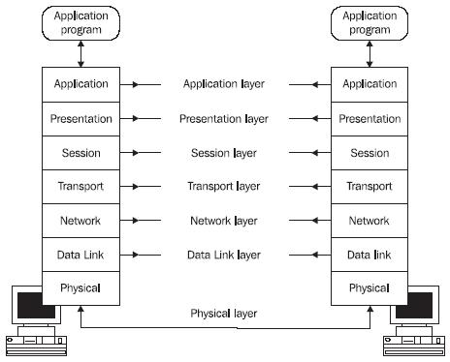
Sep 2009
Information Security by Van K Nguyen Hanoi University of Technology

Slide 3
Attacks against TCP
Sep 2009
Information Security by Van K Nguyen Hanoi University of Technology

Slide 4
Transmission Control Protocol - TCP
Connection oriented protocol for a user process
  Reliable, full-duplex channel: acknowledgements, retransmissions, timeouts
  The packets are delivered in the same order
Congestion control mechanisms
Sep 2009
Information Security by Van K Nguyen Hanoi University of Technology

Slide 5
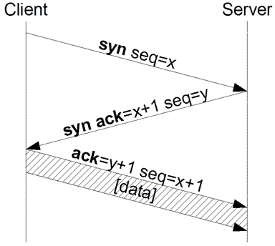
TCP 3-way handshake
The sequence number x and y are random values that the other side need to ack by increment (x+1 or y+1)
The connection only fully opened when server-side received client’s ack
Sep 2009
Information Security by Van K Nguyen Hanoi University of Technology

Slide 6
SYN Attack
An attacker sends flood of SYNs with source address spoofed packets to a target.
If the limit is reached, target machine will refuse any incoming connections till the timeout expires
  The server send the SYN-ACK to the falsified IP address, and thus never receive the ACK
    Server wait for ACK for some time, as simple network congestion could also be the cause of the missing ACK.
Spoofed address chosen to be a non-existent one
  If the spoofed address belongs to a machine, then what ?
Sep 2009
Information Security by Van K Nguyen Hanoi University of Technology

Slide 7
Why it works?
There is no authentication of the source of the packets
Addresses can be easily spoofed
Server needs to allocate a lot or resources while client doesn’t
Sep 2009
Information Security by Van K Nguyen Hanoi University of Technology

Slide 8
Some measurements to the SYN attack
Configuration Optimization
  At the server
    Reduce the timeout to 10 seconds
    Increase the size of the queue
    Disable non-essential services, reducing the number of ports to be attacked
  At all routers in the Internet
    Block packets to the outside that have source addresses from outside the internal network
Sep 2009
Information Security by Van K Nguyen Hanoi University of Technology

Slide 9
Some measurements to the SYN attack
Using firewall as relay/gateway
  Firewall acts in between, receive then forward the SYN packet to server
  Firewall send “fake” ACK to server, then wait a little timeout then send RST to server if no real ACK coming.
Active Monitoring
  Monitor the TCP traffic within a local area network and figure out which ones are illegitimate connections.
  Send RST for the illegitimate connections to close them
Sep 2009
Information Security by Van K Nguyen Hanoi University of Technology

Slide 10
TCP Congestion Control
Source determines how much bandwidth is available for it to send, it starts slow and increases the window of send packet based on ACKS.
ACKS are also used to control the transmission of packets.
Uses Additive Increase Multiplicative Decrease (AIMD)
Uses Retransmission Timeout (RTO) to avoid congestion
Sep 2009
Information Security by Van K Nguyen Hanoi University of Technology

Slide 11
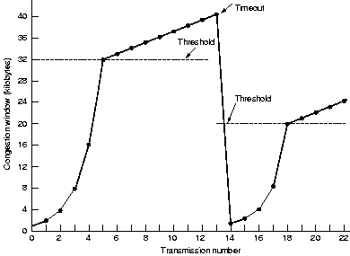
TCP Congestion Control
All the attacker needs to do is generate a TCP flow to force the targeted TCP connection to repeatedly enter a retransmission timeout state
Sep 2009
Information Security by Van K Nguyen Hanoi University of Technology

Slide 12
IPsec: secure communication for the IP layer
Sep 2009
Information Security by Van K Nguyen Hanoi University of Technology

Slide 13
Intro
Internet Protocol Security (IPsec) is a protocol suite for securing Internet Protocol (IP) communications by authenticating and encrypting each IP packet of a data stream.
  Authentication/integrity
  Confidentiality
  Protection against replayed packets
Transparent to applications
  below transport layer (TCP, UDP)
IETF IPSEC Working Group
  Documented in RFCs and Internet drafts
Sep 2009
Information Security by Van K Nguyen Hanoi University of Technology

Slide 14
Basics on IPSec
Protocols
  Internet key exchange (IKE): set up a security association (SA) with encryption and authentication keys to be used.
  Authentication Header (AH): provides integrity and authentication without confidentiality
  Encapsulating Security Payload (ESP): provides confidentiality and can also provide integrity and authentication
Both AH/ESP can operate on two different modes
  Transport-mode: encapsulates an upper-layer protocol (e.g. TCP or UDP) and prepends an IP header in clear
  Tunnel-mode: encapsulates an entire IP datagram into new packet adding a new IP header
Sep 2009
Information Security by Van K Nguyen Hanoi University of Technology

Slide 15
Transport mode
ESP in Transport Mode
  encrypts and optionally authenticates the IP payload (data), but not the IP header.
AH in Transport Mode
  authenticates the IP payload and selected portions of the IP header
Sep 2009
Information Security by Van K Nguyen Hanoi University of Technology

Slide 16
Tunnel Mode
ESP in Tunnel Mode
  encrypts and optionally authenticates the entire inner IP packet, including the inner IP header.
AH in Tunnel Mode
  authenticates the entire inner IP packet and selected portions of the outer IP header.
Sep 2009
Information Security by Van K Nguyen Hanoi University of Technology

Slide 17
Security Associations
SA- the basis for building security functions into IP.
A security association is simply the bundle of algorithm selection and parameters (such as keys) that is being used to encrypt and authenticate a particular flow in one direction.
  SPI (Security Parameter Index) + IP destination address uniquely identifies a particular Security Association.
Therefore, in normal bi-directional traffic, the flows are secured by a pair of security associations.
  SAs are unidirectional, sender supplies SPI to receiver.
Sep 2009
Information Security by Van K Nguyen Hanoi University of Technology

Slide 18
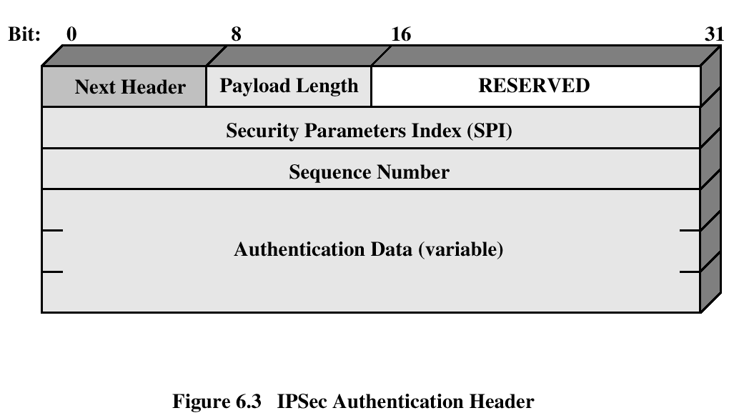
Authentication Header
Provides support for data integrity and authentication (MAC) of IP packets, using HMAC based on MD5 or SHA1.
Defends against replay attacks (sequence number)
Sep 2009
Information Security by Van K Nguyen Hanoi University of Technology

Slide 19
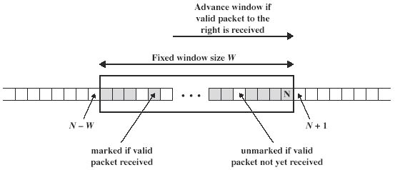
AH: Preventing Replay
When a SA is established, sender initializes sequence counter to 0.
Every time a packet is sent the counter is incremented and is set in the sequence number in the AH header.
When sequence number 2³² - 1 is reached, a new SA should be negotiated.
Sep 2009
Information Security by Van K Nguyen Hanoi University of Technology

Slide 20
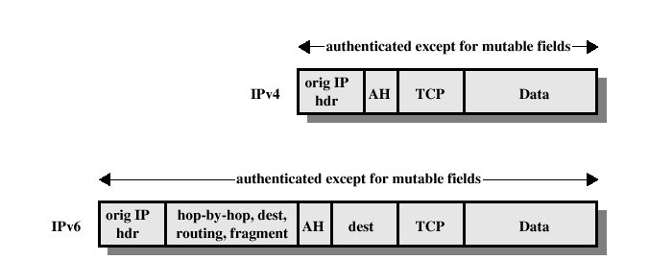
AH Authentication: Transport Mode
Sep 2009
Information Security by Van K Nguyen Hanoi University of Technology

Slide 21
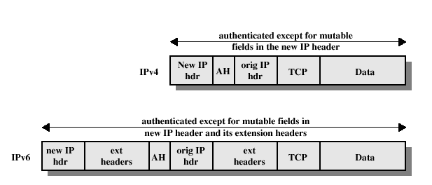
AH Authentication: Tunnel Mode
The new IP header contains different IP addresses than the ultimate destination and source
Sep 2009
Information Security by Van K Nguyen Hanoi University of Technology

Slide 22
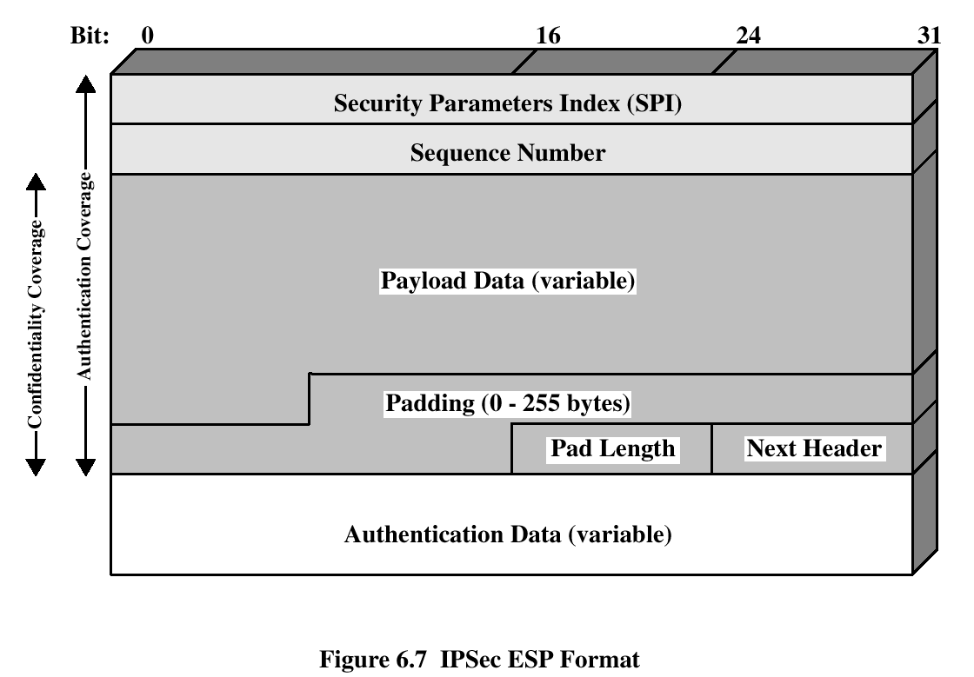
Encapsulating Security Payload
ESP provides confidentiality services, optionally can provide the same services as AH
Encryption: 3DES, Blowfish, CAST, IDEA, 3IDEA
Sep 2009
Information Security by Van K Nguyen Hanoi University of Technology

Slide 23
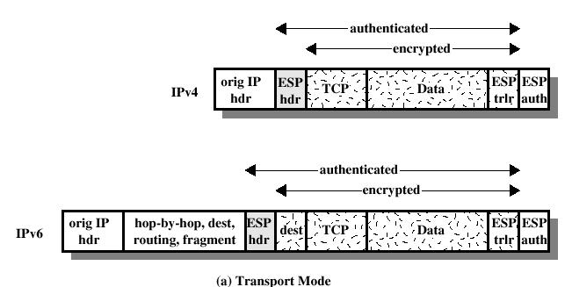
ESP Encryption and Authentication:
Transport Mode
Sep 2009
Information Security by Van K Nguyen Hanoi University of Technology

Slide 24
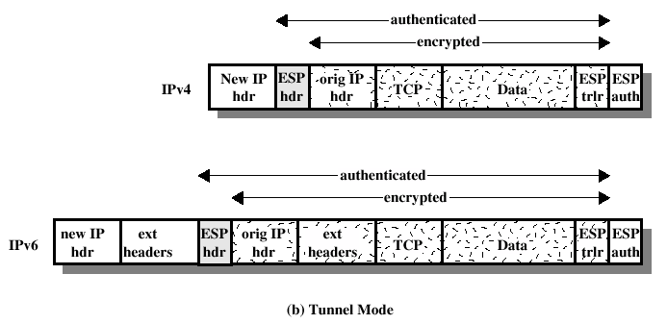
ESP Encryption and Authentication:
Tunnel Mode
Sep 2009
Information Security by Van K Nguyen Hanoi University of Technology

Slide 25
TLS/SSL: SECURE END-TO-END COMMUNICATION
Sep 2009
Information Security by Van K Nguyen Hanoi University of Technology

Slide 26
History
Netscape Communications developed the first three versions of Secure Socket Layer (SSL) with significant assistance from the Web community.
  Although SSL’s development was open, and Netscape encouraged others in the industry to participate, the protocol technically belonged to Netscape.
Beginning in May 1996, however, SSL development became the responsibility of the Internet Engineering Task Force (IETF).
The IETF renamed SSL to Transport Layer Security (TLS).
  The final version of the first official TLS specification was released in January 1999.
Despite the change of names, TLS is nothing more than a new version of SSL.
  In fact, there are far fewer differences between TLS 1.0 and SSL 3.0 than there are between SSL 3.0 and SSL 2.0.
Sep 2009
Information Security by Van K Nguyen Hanoi University of Technology

Slide 27
TLS/SSL basics
Protocol suite that allows to establish an end-to-end secure channel:
  Confidentiality: by encryption using DES, 3DES, RC2, RC4, IDEA.
  Integrity: by computing a MAC and send it with the message; MD5, SHA1.
  Key exchange: by public key encryption
Defines how the characteristics of the channel are negotiated
  key establishment, encryption cipher, authentication mechanism
Requires reliable end-to-end protocol, so it runs on top of TCP
Typically, used by other session protocols (HTTPS …)
Several implementations:
  e.g. SSLeay, open source implementation (www.openssl.org)
Sep 2009
Information Security by Van K Nguyen Hanoi University of Technology

Slide 28
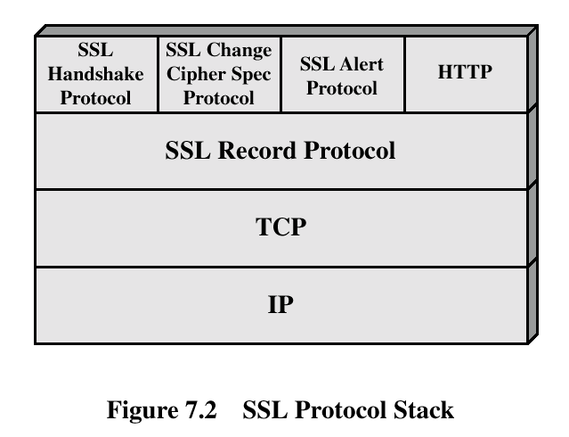
TLS: Protocol Architecture
} 2 layer protocol
Sep 2009
Information Security by Van K Nguyen Hanoi University of Technology

Slide 29
Session and Connection
Session
  association between a client and a server
  created by the Handshake Protocol
  defines secure cryptographic parameters that can be shared by multiple connections.
Connection
  end-to-end reliable secure communication
  every connection is associated with a session
Sep 2009
Information Security by Van K Nguyen Hanoi University of Technology

Slide 30
Session
Session identifier: generated by the server to identify an active or resumable session.
Peer certificate: X 509v3 certificate.
Compression method: algorithm used to compress the data before encryption.
Cipher spec: encryption and hash algorithm, including hash size.
Master secret: 48 byte secret shared between the client and server.
Is resumable: indicates if the session can be used to initiate new connections.
Sep 2009
Information Security by Van K Nguyen Hanoi University of Technology

Slide 31
Connection
Server and client random: chosen for each connection.
Server write MAC secret: shared key used to compute MAC on data sent by the server.
Client write MAC secret: same as above for the client
Server write key: shared key used by encryption when server sends data.
Client write key: same as above for the client.
Initialization vector: initialization vectors required by encryption.
Sequence numbers: both server and client maintains such a counter to prevent replay, cycle is 2⁶⁴ - 1.
Sep 2009
Information Security by Van K Nguyen Hanoi University of Technology

Slide 32

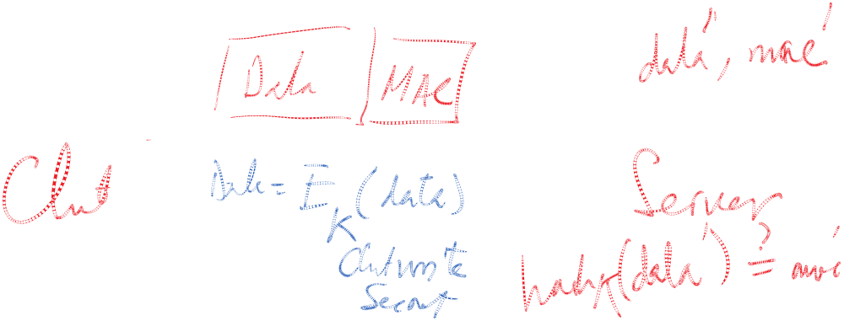


Sep 2009
Information Security by Van K Nguyen Hanoi University of Technology

Slide 33
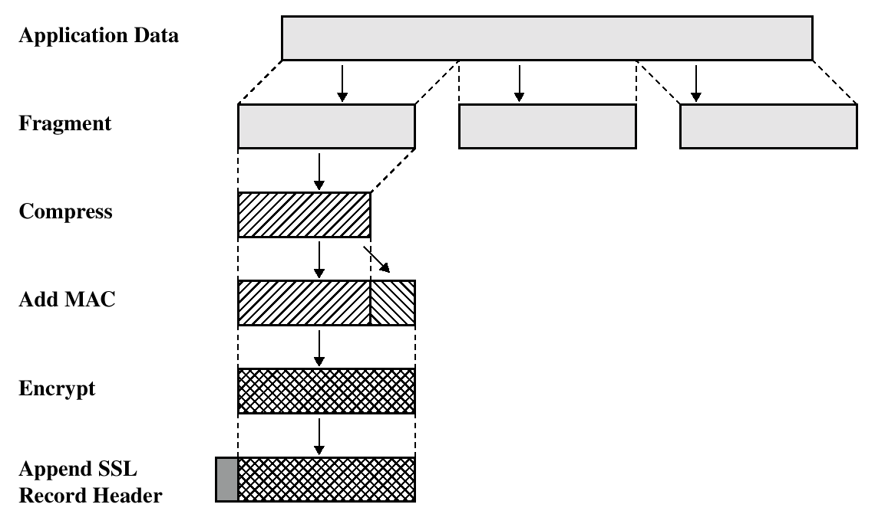
TLS: SSL Record Protocol
Provides confidentiality and message integrity using shared keys established by the Handshake Protocol
Sep 2009
Information Security by Van K Nguyen Hanoi University of Technology

Slide 34
TLS: Handshake Protocol
Negotiate Cipher-Suite Algorithms to use
  Symmetric cipher
  Key exchange method
  Message digest function
Establish the shared master secret
Optionally authenticate server and/or client
Sep 2009
Information Security by Van K Nguyen Hanoi University of Technology

Slide 35
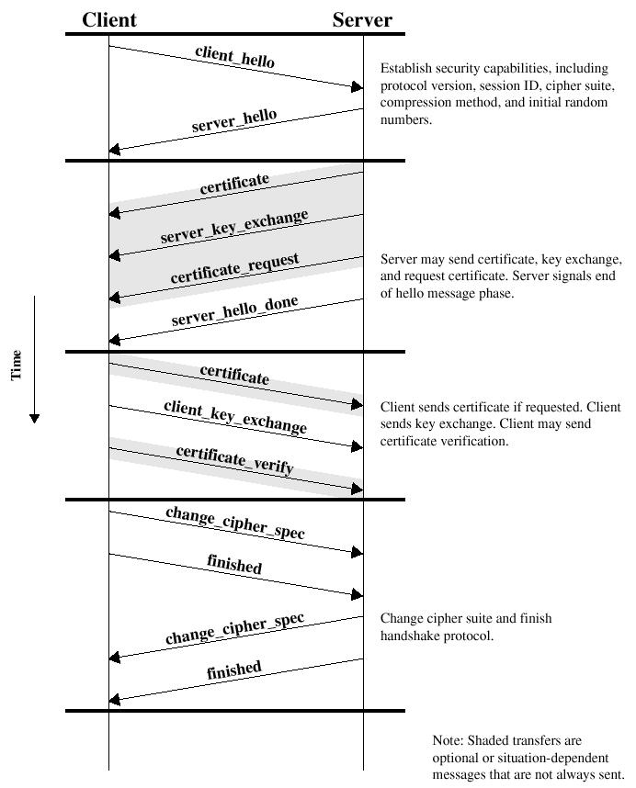
Handshake:
At a glance
Sep 2009
Information Security by Van K Nguyen Hanoi University of Technology

Slide 36
Handshake: Hellos messages
Client_hello_message has parameters:
  Version
  Random: timestamp + 28-bytes random
  Session ID
  CipherSuite: cipher algorithms supported by the client, first is key exchange
  Compression method
Server responds with the same
Client may request use of cached session
  Server chooses whether to accept or not
Sep 2009
Information Security by Van K Nguyen Hanoi University of Technology

Slide 37
Handshake: Key Exchange
Supported key exchange methods:
  RSA: shared key encrypted with RSA public key
  Fixed Diffie-Hellman
    public parameters provided in a certificate
  Ephemeral Diffie-Hellman
    Diffie-Hellman with temporary secret key, messages signed using RSA or DSS
  Anonymous Diffie-Hellman
    vulnerable to man-in-the-middle
Sep 2009
Information Security by Van K Nguyen Hanoi University of Technology

Slide 38
TLS: Authentication
Verify identities of participants
  Client authentication is optional
  Certificate is used to associate identity with public key and other attributes
Sep 2009
Information Security by Van K Nguyen Hanoi University of Technology

Slide 39
TLS: Change Cipher Spec/Finished
Change Cipher Spec completes the setup of the connections.
Announce switch to negotiated algorithms and values
The client sends a message under the new algorithms, allows verification of that the handshake was successful
Sep 2009
Information Security by Van K Nguyen Hanoi University of Technology

Slide 40
TLS vs. IPSEC
Security goals are similar
IPSec more flexible in services it provides, decouples authentication from encryption
Different granularity: IPSec operates between hosts, TLS between processes
Sep 2009
Information Security by Van K Nguyen Hanoi University of Technology

Slide 41
1. IC có quy luật liên hệ gì với văn bản mà từ đó nó được tính ra. Hãy thử so sánh giữa IC của bản mã sinh ra từ cùng một bản tin qua các hệ mã sau đây (có giải thích):
  Additive cipher
  One-time-pad cipher
  Vigenere cipher with key “loveisblue”
  Vigenere cipher with key “blue”
  DES
2. Giả sử ta dùng mật mã khối DES với khóa K và vec-tơ khởi đầu IV để bảo mật các tệp dữ liệu nhị phân trong máy tính. Như vậy một tệp dữ liệu gồm 2 khối 64 bit (X, Y) sẽ mã hóa thành (DES_{K} (X), DES_{K}(Y)) trong chế độ ECB.
Tệp dữ liệu A có biểu diễn nhị phân (X,Y,Z, X) trong đó X,Y,Z là các khối 64 bits. Cho biết dạng biểu diễn của A khi ta sử dụng chế độ mã hóa:
a) ECB b) CBC c)CTR
3. Một sinh viên có “cải tiến” sửa đổi TT trao chuyển khoá Needham-Schroeder như sau:
1) A → S: A, B, R_{A}
2) S → A: E_{KAS} (R_{A}, B, K, E_{KBS} ((K,B))
3) A → B: E_{KBS} (K,A)
4) B → A: E_{K} (R_{B})
5) A → B: E_{K} (2*R_{B})
Cho biết những chỗ sai/không hợp lý
Sep 2009
Information Security by Van K Nguyen Hanoi University of Technology

Slide 42
1. Tại sao nói độ an toàn của một hệ chữ ký điện tử phụ thuộc vào việc lựa chọn hàm băm?
Giả sử hàm băm H với đầu ra 64bit được Alice chọn xây dựng chữ ký điện tử. Eve là một kẻ gian muốn lừa dối Alice bằng cách tạo ra hai văn bản X và Y có nội dung đối nghịch nhau nhưng chữ ký của Alice lên cả 2 sẽ giống nhau. Eve có khả năng làm điều này hay không nếu có thời gian chuẩn bị khoảng 1 ngày (từ lúc biết đặc tả của H đến lúc gặp Alice), trong đó Eve có khả năng tính toán mỗi phép băm H mất 10⁻⁶s ?
2. Phát biểu định lý Euler và ý nghĩa ứng dụng của nó với việc xây dựng hệ khóa công khai. Hãy cho biết giá trị và nêu cách tính giá trị của:
φ(131) b) φ(133) c) φ(30)
3. Một sinh viên có “cải tiến” sửa đổi TT trao chuyển khoá Needham-Schroeder như sau:
1) A → S: A, B, R_{A}
2) S → A: E_{KAS} (R_{A}, B, K, E_{KBS} ((K,B))
3) A → B: E_{KBS} (K,A)
4) B → A: E_{K} (R_{B})
5) A → B: E_{K} (2*R_{B})
Cho biết những chỗ sai/không hợp lý
Sep 2009
Information Security by Van K Nguyen Hanoi University of Technology

